Slide 1
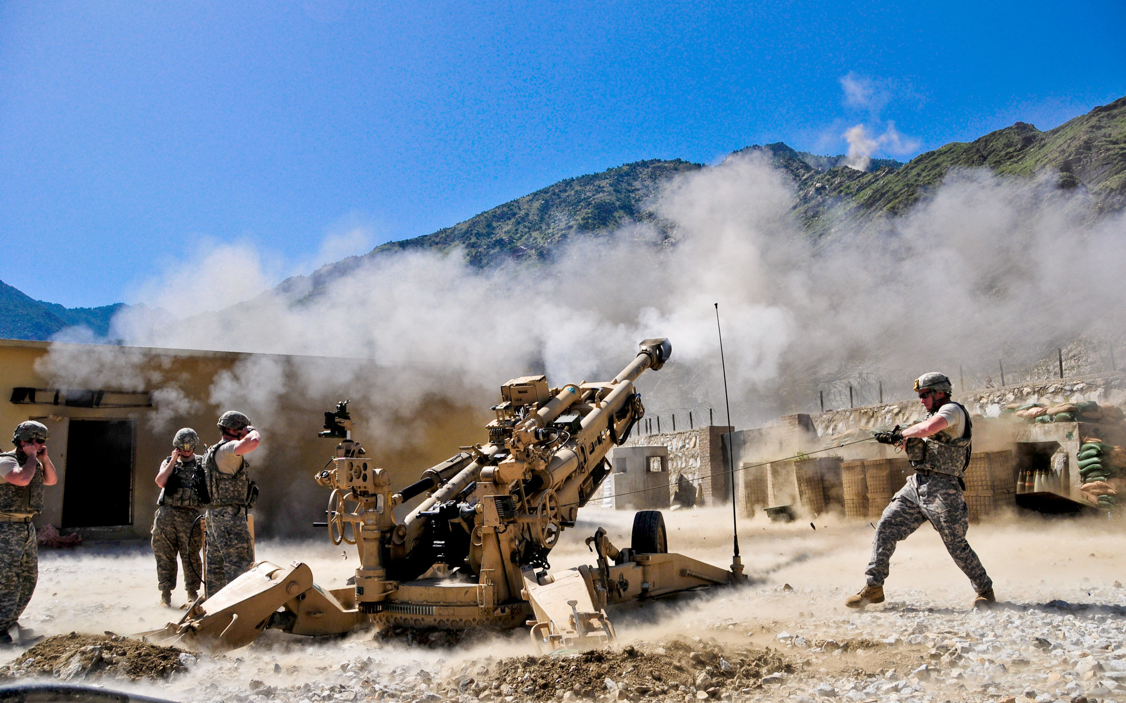
UAV With Integrated Observation System For Artillery Fire Guidance
PI : Prof. Dr. Md. Mahbubur Rahman
Associate: Major Mokhles
Lec Nafiz Imtiaz Khan

Slide 2
Outline
Background
Motivation
Proj Overview- Present System
Proj Objectives
Proposed Methodology (Phasing)
Proposed Timeline to Implement proj
Progress so far, RA Reqr
Challenges
Conclusion

Slide 3
Background
The Corps of Artillery also known as ‘GOD OF THE BATTLE’ plays a decisive role to dominate a war and win any battle.
During liberation war of 1971, Corps of Artillery was first raised in BD Army.
Presently Corps of Artillery is catagorize in two types : Field Artillery and Air Defence Artillery.

Slide 4
Motivation
To get decisive success in battlefield practice in peace time is very crucial.
Present practice system is manual.
With high error margin and also time consuming
Automate the system will eliminate shortcomings
Notes:
where an observer detects the impact points and send necessary feedback for correction and guidance of the subsequent fires.

Slide 5
Present System
When a shell is fired an observer who is positioned near to the target area tries to identify the impact points and sends feedback.
In observer’s feedback the approximate position of the hit is mentioned and if it is a blind shell the probable location of the shell is referenced for disposing by Engineer’s support.
According to the feedback, necessary adjustments are done to bring accurate fire on the target area.

Slide 6
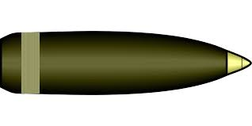
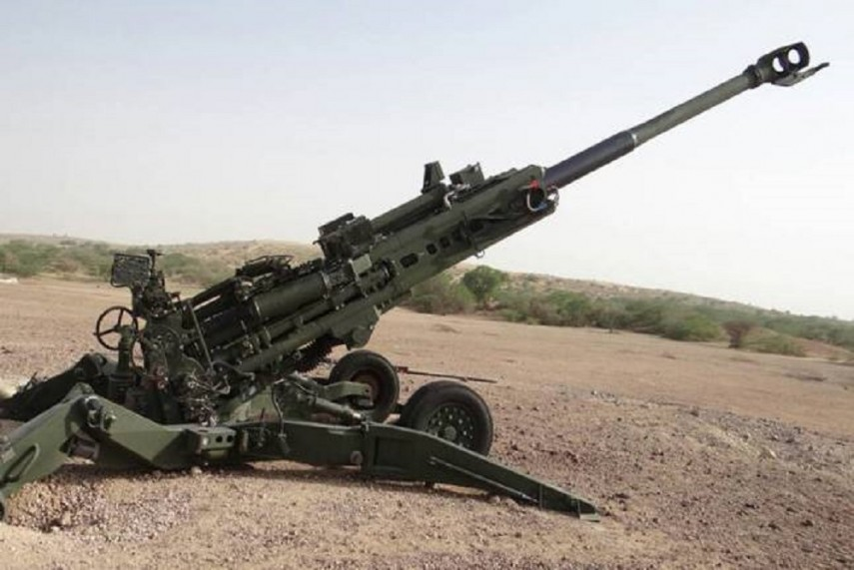

OBSERVER
DISTANCE 16/35/50 KM
RADIUS 300-400 m
TARGET OBJECT

Slide 7
Merits of Existing System
Easy to implement.
Correction and detection procedure is simple.
Training people is comparatively easier.
No modern technology/equipment is used.

Slide 8
Demerits of Existing System
Detection and feedback method is manual
Time consuming
Takes more human effort
Gross error margin
Less efficient

Slide 9
Proposed Solution : Two Phases Development
1
System analysis, design and prototype implementation- mainly camera based
2
Integrated camera and Drone based localization confirmation system

Slide 10
System Planning
01
Using radar technology to detect the shell
02
Using high speed motion capture camera
03
Using thermal camera
04
Using thermal camera with drones

Slide 11
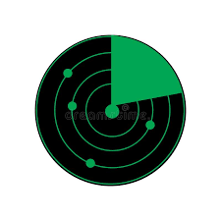
Radar based Solution
Pros:
Pinpoint the exact location of the shell’s descendent point
We can observe the trajectory and speed of the shell using radar technology.
Cons:
The cost of a radar prohibitively high. Legal regulations are there.

Slide 12
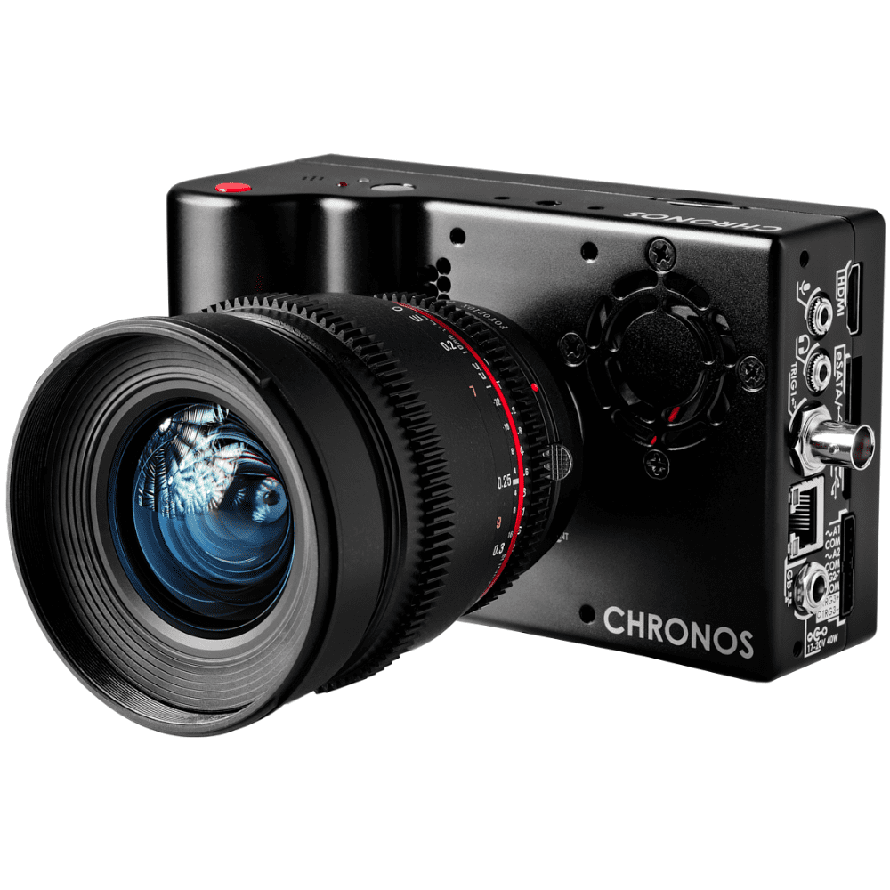
Using High Speed Motion Capture Camera
Pros:
The cost of a motion capture camera is much less than a radar or a thermal camera
Cons:
Depending on the product, the image processing may or may not be able to appropriately locate the shell
Since we are locating the shell based on pure image processing, the accuracy might be lower than expected

Slide 13
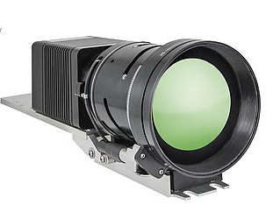
Using Thermal Camera
Pros:
The shell is easily detected due to the sheer heat the shell generates as it leaves the barrel.
As the shell explodes on site, we can determine if the target has been hit or missed.
In case of blind shell, we can detect the exact location of the spot as the shell leaves behind a huge heat signature.
Thermal image can detect even the slightest change in heat so the possibility of success increases drastically.

Slide 14
Using Thermal Camera
Cons:
The price of a thermal camera is much higher than that of a high speed motion capture camera.
The quality of thermal image is equipment dependent and so results may vary depending on the type of equipment used during testing.
In-built thermal camera in drones are harder to obtain than regular drones.

Slide 15
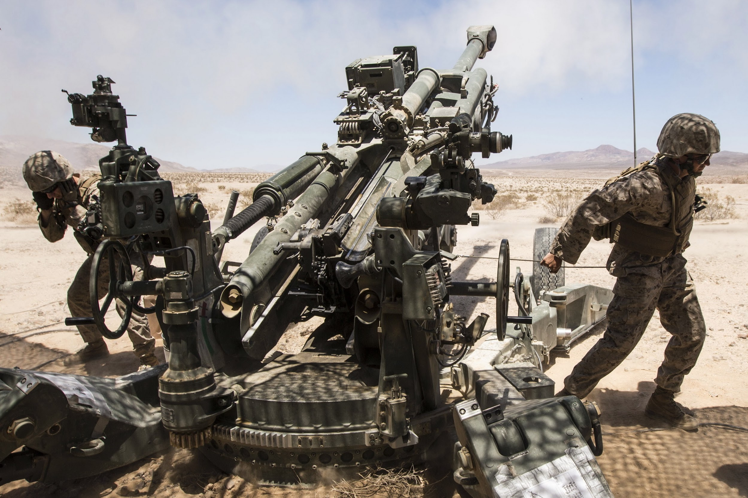
Methodology for Static Approach

Slide 16
Thermal Imaging System
we are targeting to use a thermal sensor because of the significant heat signature of a fired shell
High Mast Lighting Pole
Equipment
we have to elevate the thermal camera system and for that, we are intending to use a High Mast Lighting Pole which can easily give us a ground clearance up to 30 meters.
For Static
testing
Computational Device
As this is a very sophisticated process and the workload is very high, we need good computational power for that.

Slide 17
Working Methodology
Setting Up The High Mast Lighting Pole We will set the High Mast Lighting Pole at such a distance from the pre-located bombing area that the overall effects like heat, smoke, vibration, and others are minimized without losing the close surveillance of the thermal imaging system.

Slide 18
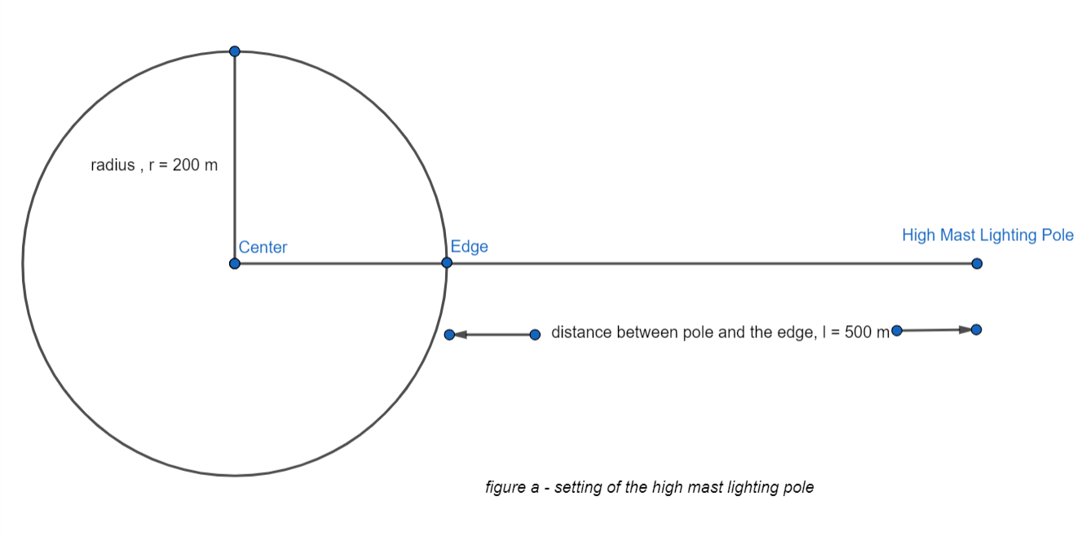
Working Methodology

Slide 19
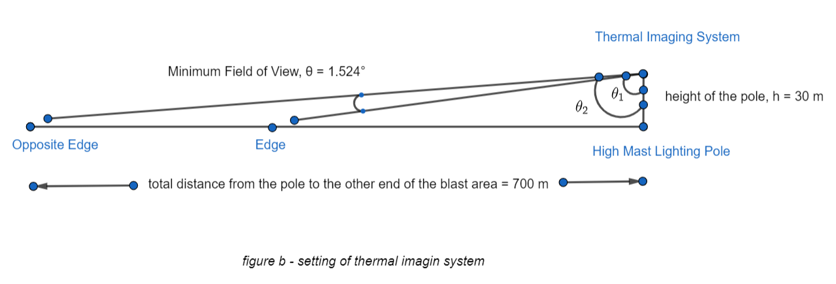
Working Methodology
Positioning the Thermal Imaging System
Now we will safely place the thermal imaging system on top of the pole. This will give us the desired ground clearance which is necessary for the overall observation and tracking of the shell.

Slide 20
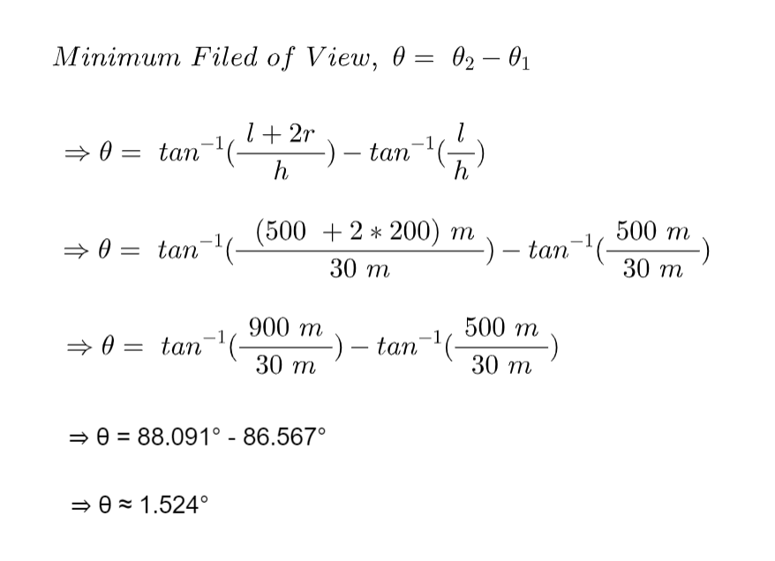
Working Methodology

Slide 21
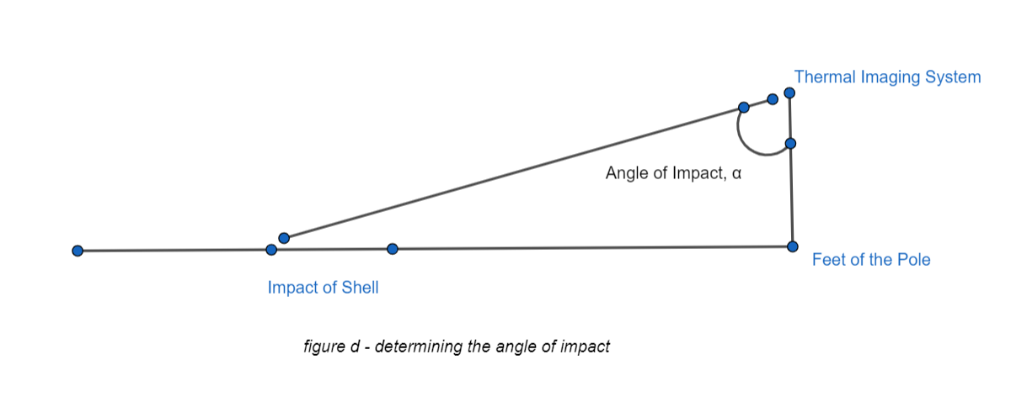
Working Methodology
Calculating the average angle deviation per axis
As our main focus is to determine the distance between the impact point and the pole’s feet known as the angle of impact denoted by α. Here the angle from the thermal camera to the impact point is very crucial.

Slide 22
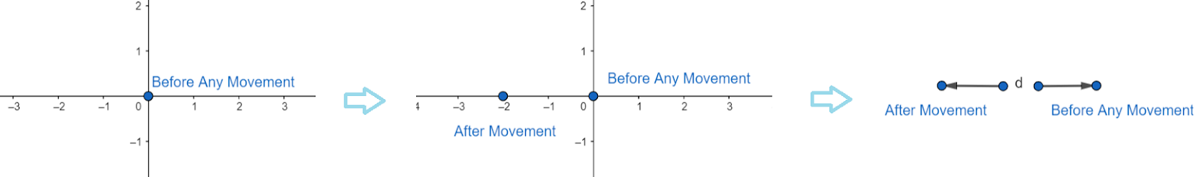
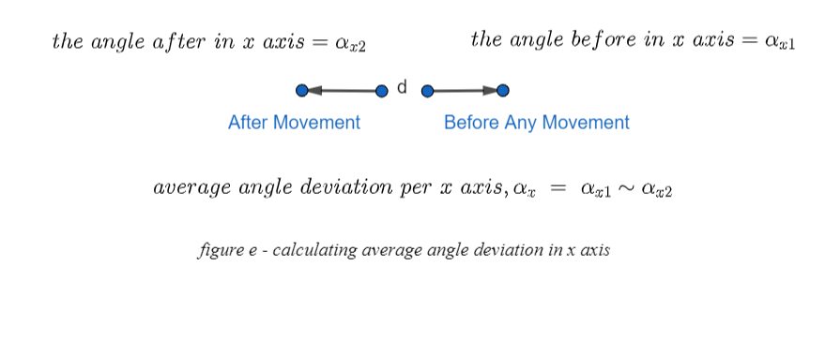
Working Methodology

Slide 23
Working Methodology
4. Capture the video of the falling shell
As we are using a thermal camera that would be stationary. The main focus of the thermal imaging system should be such that the blast area is its main focus. Also, the field of view of these cameras is ample so the blast area must be at the center of the frame. Now the system will be in video mode as the shell is shot for the target. So from this, we will get the thermal footage for a single fire.

Slide 24
Working Methodology
5. Modify the thermal video footage
As we are working with shells or some sort of missiles then we must consider the fact that they are having a great speed. That is why before proceeding to the next step we may have to slow the video. So that, in every frame we get a better localization of the thermally heated shell in the video frames. This step is a process that needs to be observed and analyzed in real-time for better performance

Slide 25
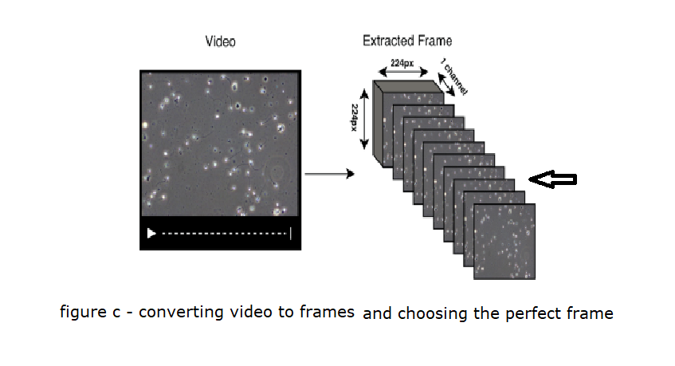
Working Methodology
Convert the thermal video into single thermal frames
Now the thermal video footage needs to be converted into thermal frames or single images. For that, we are using a technology called FFMPEG which is noted as a cross-platform solution for media conversions and specifically framing a video into single images. This will give us images of every time interval of the shell. In this way, we will be able to detect the shell at any given time just by observing the frame or the single picture of that time.

Slide 26
Working Methodology
7. Choose the optimal frame of impact
This time we are going to take the best thermal frame that is the impact point for the shell. Meaning just before the impact it could be a blast or a shell getting down into the soil or known as being blind, we will consider these two cases and we have to choose such a frame that is the accurate one. Here image processing and machine learning will help us greatly. Doing much processing we are now with the perfect frame that is best for our further processing.
8. Detect the shell in the perfect fram
As we are using a thermal camera our video, as well as the chosen frame or image, will be a thermal image. So being a heated object, the fired shell’s heat signature is greater than the environment’s heat signature. Using this concept, we will try to detect the shell from that single frame. Here OpenCV will be very applicable. So by doing these we can easily detect the position of the shell in the frame.

Slide 27
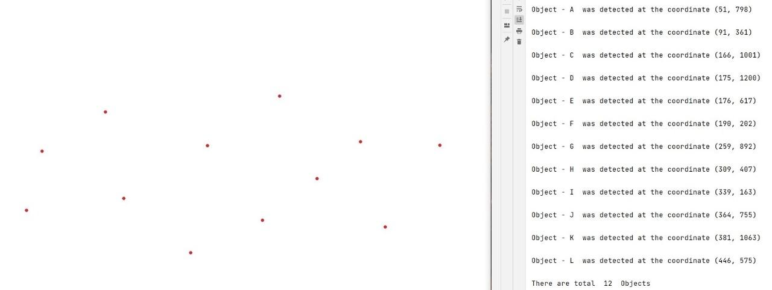
Working Methodology
Detecting thermal points and their co-ordinates from a picture

Slide 28
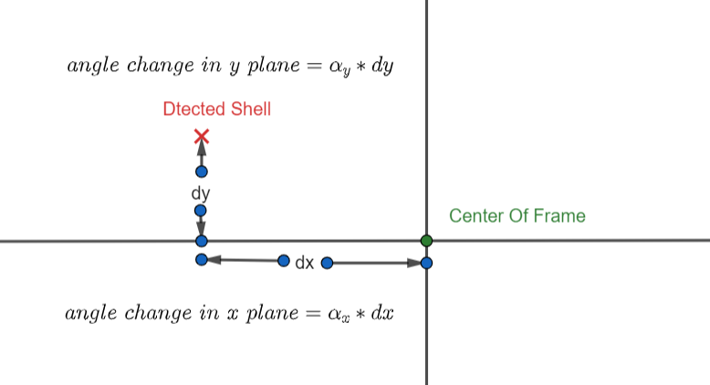
Working Methodology
9. Determining the angle of impact from the chosen frame
This time we are gonna determine the pixel location of the detected shell in the desired frame. After the localization, we have to check how much deviated from the center point of the entire frame. This deviation can be divided into 2 parts or axis as X-axis and Y-axis. So from these deviations, we can get to know how much change in the X-axis and how much change in the Y-axis has to be done. After we get these two modifications we can easily calculate the angle of impact for that particular shell, correcting from the main camera’s viewing angle.

Slide 29
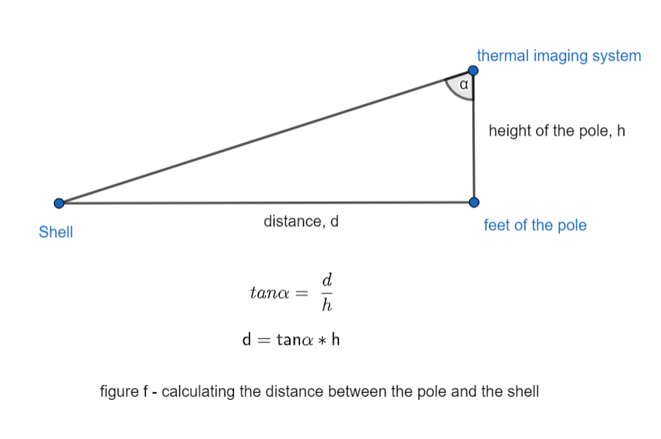
Working Methodology
10. Calculating the distance from shell to pole Now as the height of the pole is fixed and we have got the angle of impact for the shell we can easily put some trigonometry and figure out the distance from the pole to the shell’s impact point. This math can be solved like the following picture.

Slide 30
Working Methodology
11. Determining the GPS of the position of the impact point
As we know the distance between a reference point (pole) and the impact point. So by knowing the GPS of the pole’s location or the thermal imaging system’s location or the point of reference we can easily get the direction using the compass and from those, we can determine the GPS of the impact point.
So by going through all these steps we can see how we can determine the GPS of the impact point which will be then given as feedback for the firing squad. This is a theoretical approach that we have planned which needs to be tested in real-time for the proper results and other modifications.

Slide 31
PROPOSED TIMELINE
Phase | Software | Hardware | Budget | Time
Phase-1 | Customize soft for colleting data from camera | Camera Mast Cable | 200000 100000 22 | 6 month Jan 2022-Dec 2002
Phase -2 |  | Drove

Slide 32
PROGRESS SO FAR
Phasing
Working
Software
Hardware
+ Budget

Slide 33
Purchase and Implementation Plan

Slide 34
COST:
a. Phase-1.
1) Cost Limitation. Approved budget is 500,000 BDT.
2) Cost Breakdown.
a) Thermal Camera.
3 * Ranger HRC (Total Approximately >= 500,000 BDT each). b) Pole.
3 * High Mast Lighting Pole (Total Approximately 100,000 BDT).

Slide 35
b. Phase-2.
1) Cost Breakdown.
a) Drone.
i) 1 * DJI MATRICE 300 RTK DRONE
(1,164,500 BDT).
Or
ii) 1 * DJI MAVIC 2 ENTERPRISE ADVANCED (590,039 BDT).
Both the drones exceed our budget limitation. However, considering hardware limitation DJI MATRICE 300 RTK is preferable.

Slide 36
b) Thermal Camera:
1 * DJI ZENMUSE XT (299,295 BDT)
c) Servers/ Terminals: Approximately
(200,000 BDT).
c) Accessories and software implementation: 3,35000 BDT
d) Total Cost: 20,00000 BDT Approximately

Slide 37
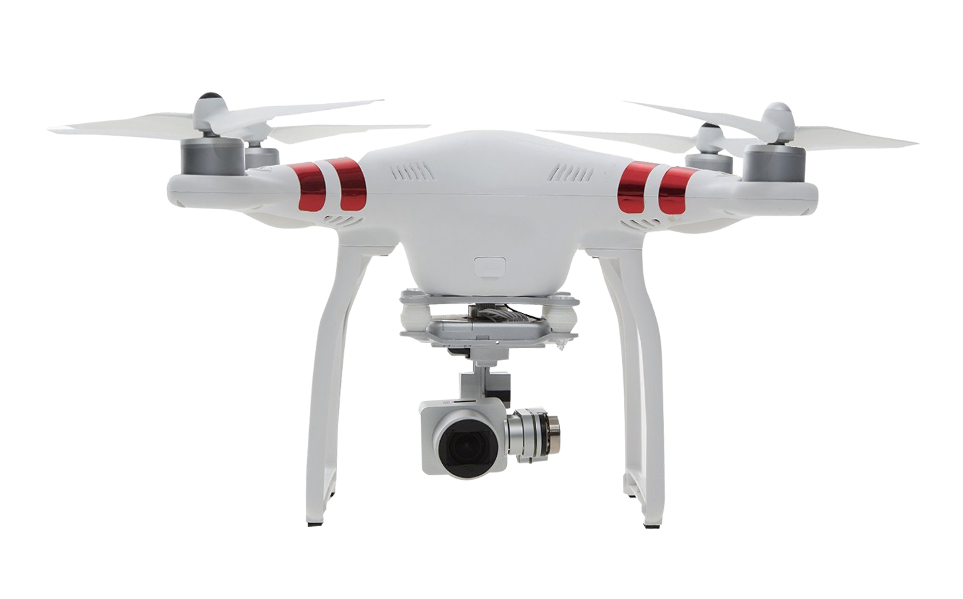
2nd Phase of Work: thermal camera with drones

Slide 38
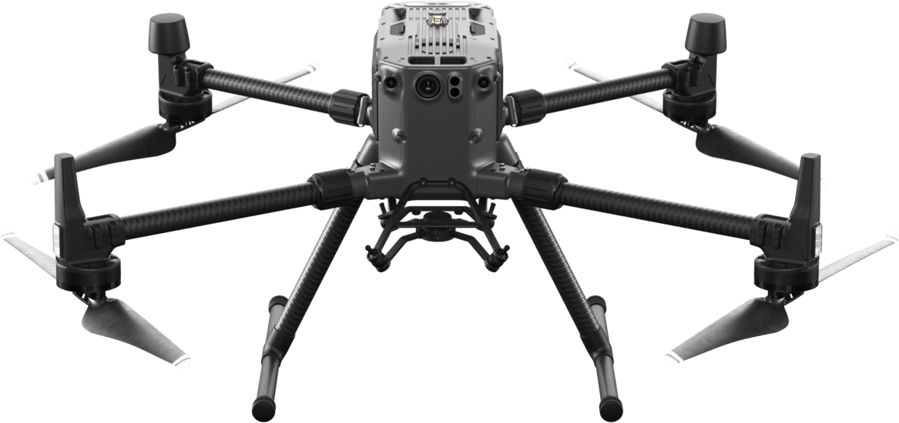
Preferred Drone
The Matrice 300 RTK sets a new standard for industrial drones by combining intelligence with high-performance and unrivaled reliability.
55 min Max Flight Time
15km 1080p map transmission
6 Directional Sensing and Positioning
-20°C to 50°C operating temperature
DJI Matrice 300 rtk

Slide 39
Preferred Drone
The Matrice 300 RTK sets a new standard for industrial drones by combining intelligence with high-performance and unrivaled reliability.
55 min Max Flight Time
15km 1080p map transmission
6 Directional Sensing and Positioning
-20°C to 50°C operating temperature
DJI Matrice 300 rtk

Slide 40
Progress So Far
Understanding the system (Analysis)
System planning
Methodology ( Initial Design)
Prototype Implementation is on progress

Slide 41
CONCLUSION
To investigate the possibility of a UAV Based artillery fire guidance system will address present systems limitations and open up further research in shell detection and tracking.
Integration of AI in the proposed system is under consideration.

